Slide 2
Introduction to Docker
Docker is an open source project that automates the deployment of applications insift software containers.
Docker provides an additional layer of abstraction and automation of OS virtualization on Linux.

Slide 3
Introduction to Docker
Docker is basically a tool (or set of tools) that package up an application and its dependencies in a “virtual container” so that it can run on any Linux distribution.
The O/S inside the docker container emulates Linux, but Docker itself can run on Linux, Windows or MacOS X

Slide 4
Introduction to Docker
The O/S inside the docker container emulates Linux, but Docker itself can run on Linux, Windows or MacOS X
For Windows, docker requires a lightweight virtual machine to run. #
An example of this might be the Vagrant application, commonly used with Docker.

Slide 5
Introduction to Docker
When should we use Docker?
Configuration simplification
Enhance developer productivity
Server consolidation and management
Application Isolation
Rapid deployment
Build Management.

Slide 6
Introduction to Docker
Docker gives us the ability to isolate our applications
Docker allows us to standardize our build and deployment process.
Create standard, repeatable processes.

Slide 7
Introduction to Docker
What is the difference between Docker and a Virtual Machine?
A virtual machine (or VM) is an emulation of a specific computer system type.
VM’s operate based on the architecture and functions of that real computer.
Examples of VM systems are VMWare, Citrix, and VirtualBox.

Slide 8
Introduction to Docker
Virtualization software allows you to set up one operating system within another.
Although VM’s share physical hardware with the underlying host system, the VM is isolated from the hardware
VM’s must communicate to the hardware via a hypervisor.
An AWS EC2 instance is an example of a VM.

Slide 9
Introduction to Docker
What is a container? How is it different than a VM?
A container is an isolated set of packages, libraries and/or applications that are completely independent from its surroundings.

Slide 10
Introduction to Docker
Virtualization was invented to allow us to maximize our physical server performance.
With virtualization we can share but segregate server instances from each other.
Containers are more granular.
Containers use shared operating systems
Containers are a more efficient use of system resources.

Slide 11
Introduction to Docker
Docker is a client-server application where both the daemon and the client can be run on the same system.
Alternatively, a docker client can connect to a remote docker daemon.
Docker clients and daemons communicate via sockets or through a RESTful API.

Slide 12
Introduction to Docker
The main components of Docker are:
  The Daemon
  The Client
  The Docker.io registry.

Slide 13
Introduction to Docker
Instead of virtualizing hardware, containers rest on top of a single Linux instance.
This makes Docker smaller and more efficient than a full hardware hypervisor.

Slide 14
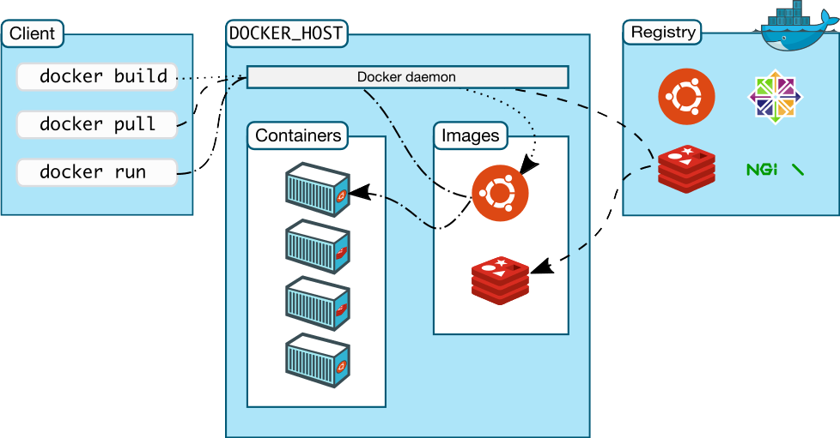
Introduction to Docker
.

Slide 15
Introduction to Docker
Docker consists of the following components:
The Docker daemon (dockerd)
Dockerd listens for Docker API requests and manages Docker objects such as images, containers, networks, and volumes.
A daemon can also communicate with other daemons to manage Docker services.

Slide 16
Introduction to Docker
The Docker client (docker) is the primary way that many Docker users interact with Docker.
When you use commands such as docker run, the client sends these commands to dockerd, which carries them out.
The docker command uses the Docker API. The Docker client can communicate with more than one daemon.

Slide 17
Introduction to Docker
A Docker registry stores Docker images. Docker Hub is a public registry that anyone can use, and Docker is configured to look for images on Docker Hub by default.
You can even run your own private registry. If you use Docker Datacenter (DDC), it includes Docker Trusted Registry (DTR).

Slide 18
Introduction to Docker
When you use the docker pull or docker run commands, the required images are pulled from your configured registry.
When you use the docker push command, your image is pushed to your configured registry.

Slide 19
Introduction to Docker
When you use Docker, you are creating and using images, containers, networks, volumes, plugins, and other objects.
The next few slides illustrate a brief overview of some of those objects.

Slide 20
Introduction to Docker
An image is a read-only template with instructions for creating a Docker container.
Often, an image is based on another image, with some additional customization.
For example, you may build an image which is based on the ubuntu image, but installs the Apache web server and your application, as well as the configuration details needed to make your application run.

Slide 21
Introduction to Docker
You might create your own images or you might only use those created by others and published in a registry.
To build your own image, you create a Dockerfile with a simple syntax for defining the steps needed to create the image and run it.
Each instruction in a Dockerfile creates a layer in the image.

Slide 22
Introduction to Docker
When you change the Dockerfile and rebuild the image, only those layers which have changed are rebuilt.
This is part of what makes images so lightweight, small, and fast, when compared to other virtualization technologies.

Slide 23
Introduction to Docker
A container is a runnable instance of an image.
You can create, start, stop, move, or delete a container using the Docker API or CLI.
You can connect a container to one or more networks, attach storage to it, or even create a new image based on its current state.

Slide 24
Introduction to Docker
By default, a container is relatively well isolated from other containers and its host machine.
You can control how isolated a container’s network, storage, or other underlying subsystems are from other containers or from the host machine.
A container is defined by its image as well as any configuration options you provide to it when you create or start it.

Slide 25
Introduction to Docker
When a container is removed, any changes to its state that are not stored in persistent storage disappear.
The following command runs an ubuntu container, attaches interactively to your local command-line session, and runs /bin/bash.
$ docker run -i -t ubuntu /bin/bash

Slide 26
Introduction to Kubernetes
Kubernetes in an open source container management tool hosted by Cloud Native Computing Foundation (CNCF).
This is also known as the enhanced version of Borg which was developed at Google to manage both long running processes and batch jobs, which was earlier handled by separate systems.

Slide 27
Introduction to Kubernetes
Kubernetes comes with a capability of automating deployment, scaling of application, and operations of application containers across clusters.
It is capable of creating container centric infrastructure.

Slide 28
Introduction to Kubernetes
Following are some of the important features of Kubernetes.
  Continues development, integration and deployment
  Containerized infrastructure
  Application-centric management
  Auto-scalable infrastructure

Slide 29
Introduction to Kubernetes
  Environment consistency across development testing and production
  Loosely coupled infrastructure, where each component can act as a separate unit
  Higher density of resource utilization
  Predictable infrastructure which is going to be created

Slide 30
Introduction to Kubernetes
One of the key components of Kubernetes is, it can run application on clusters of physical and virtual machine infrastructure.
It also has the capability to run applications on cloud. It helps in moving from host-centric infrastructure to container-centric infrastructure.

Slide 31
Introduction to Kubernetes
As seen in the following diagram, Kubernetes follows client-server architecture. Wherein, we have master installed on one machine and the node on separate Linux machines.

Slide 32
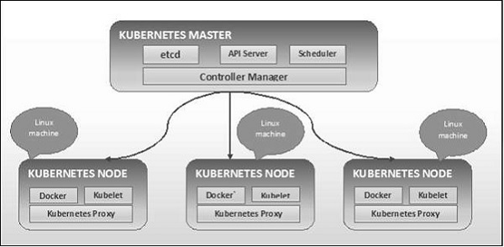
Introduction to Kubernetes

Slide 33
Introduction to Kubernetes
Following are the components of Kubernetes Master Machine.
  Etcd
  API Server
  Controller Master
  Scheduler

Slide 34
Introduction to Kubernetes
Etcd stores the configuration information which can be used by each of the nodes in the cluster.
It is a high availability key value store that can be distributed among multiple nodes.
It is accessible only by the Kubernetes API server as it may have some sensitive information.

Slide 35
Introduction to Kubernetes
Kubernetes is an API server which provides all the operation on cluster using the API.
The API server implements an interface, which means different tools and libraries can readily communicate with it.
Kubeconfig is a package along with the server side tools that can be used for communication.
Kubeconfig exposes Kubernetes API.

Slide 36
Introduction to Kubernetes
The controller manager is the component that is responsible for most of the collectors that regulates the state of cluster and performs a task.
In general, it can be considered as a daemon which runs in nonterminating loop and is responsible for collecting and sending information to API server.

Slide 37
Introduction to Kubernetes
It works toward getting the shared state of cluster and then make changes to bring the current status of the server to the desired state.
The key controllers are replication controller, endpoint controller, namespace controller, and service account controller.
The controller manager runs different kind of controllers to handle nodes, endpoints, etc.

Slide 38
Introduction to Kubernetes
The scheduler is one of the key components of the Kubernetes master.
It is a service in the master responsible for distributing the workload.
It is responsible for tracking utilization of the work load on cluster nodes and then placing a task on which resources are available and can accept the workload.

Slide 39
Introduction to Kubernetes
In other words, this is the mechanism responsible for allocating pods to available nodes.
The scheduler is responsible for workload utilization and allocating pod to new node.

Slide 40
Introduction to Kubernetes
Following are the key components of the node server which are necessary to communicate with Kubernetes master.
Docker
  The first requirement of each node is Docker which helps in running the encapsulated application containers in a relatively isolated but lightweight operating environment.

Slide 41
Introduction to Kubernetes
Kubelet Service
  This is a small service in each node responsible for relaying information to and from control plane service.
  It interacts with etcd store to read configuration details and write values.
  This communicates with the master component to receive commands and work.

Slide 42
Introduction to Kubernetes
Kubelet Service
  The kubelet process then assumes responsibility for maintaining the state of work and the node server.
  It manages network rules, port forwarding, etc.

Slide 43
Introduction to Kubernetes
Kubernetes Proxy Service
  This is a proxy service which runs on each node and helps in making services available to the external host.
  It helps in forwarding the request to correct containers and is capable of performing primitive load balancing.

Slide 44
Introduction to Kubernetes
Kubernetes Proxy Service
  It makes sure that the networking environment is predictable and accessible and at the same time it is isolated as well.
  It manages pods on node, volumes, secrets, creating new containers’ health checkup, etc.

Slide 45
Introduction to Kubernetes
Following is a diagram showing the structure of the Kubernetes master and nodes.

Slide 46
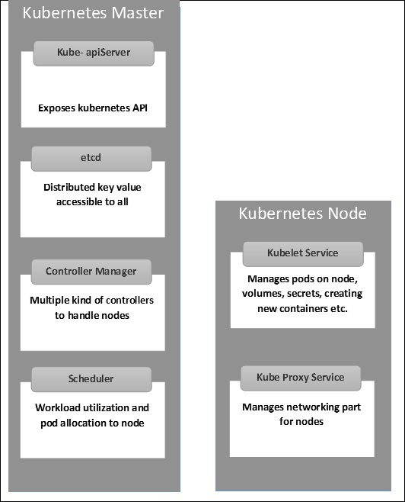
Introduction to Kubernetes

Slide 47
Introduction to Kubernetes
Kubernetes (Docker) images are the key building blocks of Containerized Infrastructure.
Each container in a pod has its Docker image running inside it.
When we configure a pod, the image property in the configuration file has the same syntax as the Docker command does.

Slide 48
Introduction to Kubernetes
The configuration file has a field to define the image name, which is generally pulled from the docker registry.
The next slide shows an example of a Kubernetes configuration which pulls a docker image and runs the container in a Kubernetes pod.

Slide 49
Introduction to Kubernetes
apiVersion: v1 kind: pod metadata: name: Testing_for_Image_pull spec: containers: - name: neo4j-server image: <Name of the Docker image> imagePullPolicy: Always command: ["echo", "SUCCESS"]

Slide 50
Introduction to Kubernetes
Some things to note in the previous example.
  The first name directive gives the container name that will be passed to Kubernetes when we create it.
  The second name is the name that will be displayed when we run the container.
  Image is the name of the image that will be pulled from the repository.

Slide 51
Introduction to Kubernetes
Some things to note in the previous example.
  Image pull policy. Tells kubernetes that when we create this container again, it will pull the same name.
  Command: What will be displayed if the container is created successfully.

Slide 52
Introduction to Kubernetes
To create this container, we run the following command:
kubectl create –f Testing_for_Image_pull

Slide 53
Introduction to Kubernetes
A pod is a collection of containers and its storage inside a node of a Kubernetes cluster.
It is possible to create a pod with multiple containers inside it. For example, keeping a database container and data container in the same pod.

Slide 54
Introduction to Kubernetes
There are two types of Pods −
  Single container pod
  Multi container pod

Slide 55
Introduction to Kubernetes
Single Container Pod
They can be simply created with the kubectl run command, where you have a defined image on the Docker registry which we will pull while creating a pod.
For example:
kubectl run <name of pod> --image=<name of the image from registry>

Slide 56
Introduction to Kubernetes
Example: Creating a pod that runs a Tomcat docker image.
kubectl run tomcat --image = tomcat:8.0

Slide 57
Introduction to Kubernetes
Alternatively, we can run the Tomcat container by defining it via a .yaml file.
apiVersion: v1 kind: Pod metadata: name: Tomcat spec: containers: - name: Tomcat image: tomcat: 8.0 ports: containerPort: 7500 imagePullPolicy: Always

Slide 58
Introduction to Kubernetes
Once we’ve saved the file (calling it, for example, tomcat.yml) we can run kubectl create like so:
We can then run the kubectl describe command to get information about that pod.
kubectl create –f tomcat.yml

Slide 59
Introduction to Kubernetes
We can also create multi container pods in the same way.
Following is an example of creating a pod with two containers, one for tomcat and one for mongodb.

Slide 60
Introduction to Kubernetes
apiVersion: v1 kind: Pod metadata: name: Tomcat spec: containers: - name: Tomcat image: tomcat: 8.0 ports: containerPort: 7500 imagePullPolicy: Always -name: Database Image: mongoDB Ports: containerPort: 7501 imagePullPolicy: Always

Slide 61
Introduction to Kubernetes
Kubernetes configuration files uses the concepts of labels and selectors.
Labels are key/value pairs that are attached to objects, such as pods.
Labels are intended to be used to specify identifying attributes of objects that are meaningful and relevant to users, but do not directly imply semantics to the core system

Slide 62
Introduction to Kubernetes
Labels can be used to organize and to select subsets of objects.
Labels can be attached to objects at creation time and subsequently added and modified at any time.
Each object can have a set of key/value labels defined. Each Key must be unique for a given object.

Slide 63
Introduction to Kubernetes
Here is an example of using labels:
apiVersion: v1 kind: Pod metadata: name: my-pod labels: environment: staging team: kube-team spec: containers: - name: my-container image: "k8s.gcr.io/my-app:v0.1" resources: limits: cpu: 1

Slide 64
Introduction to Kubernetes
It is a good practice to always get in the habit of labeling all of your Kubernetes objects.
Labels are meaningful to both Kubernetes and to the DevOps team managing the cluster(s).
Kubernetes will also provide pre-populated labels.

Slide 65
Introduction to Kubernetes
Labels do not provide uniqueness.
In general, we can say many objects can carry the same labels.
Label selectors are a core grouping primitive in Kubernetes. They are used by the users to select a set of objects.

Slide 66
Introduction to Kubernetes
Kubernetes API currently supports two type of selectors −
  Equality-based selectors
  Set-based selectors

Slide 67
Introduction to Kubernetes
A label selector can be made of multiple requirements which are comma-separated.
In the case of multiple requirements, all must be satisfied so the comma separator acts as a logical AND (&&) operator.

Slide 68
Introduction to Kubernetes
Equality-based requirement
Equality- or inequality-based requirements allow filtering by label keys and values.
Matching objects must satisfy all of the specified label constraints, though they may have additional labels as well.

Slide 69
Introduction to Kubernetes
Three kinds of operators are admitted =,==,!=. The first two represent equality (and are simply synonyms), while the latter represents inequality. For example:
environment = production tier != frontend

Slide 70
Introduction to Kubernetes
In the examples, the former selects all resources with key equal to environment and value equal to production.
The latter selects all resources with key equal to tier and value distinct from frontend, and all resources with no labels with the tier key.

Slide 71
Introduction to Kubernetes
One usage scenario for equality-based label requirement is for Pods to specify node selection criteria.
For example, the sample pod below selects nodes with the label
accelerator=nvidia-tesla-p100

Slide 72
Introduction to Kubernetes
apiVersion: v1 kind: Pod metadata: name: cuda-test spec: containers: - name: cuda-test image: "k8s.gcr.io/cuda-vector-add:v0.1" resources: limits: nvidia.com/gpu: 1 nodeSelector: accelerator: nvidia-tesla-p100

Slide 73
Introduction to Kubernetes
Set-based label requirements allow filtering keys according to a set of values.
Three kinds of operators are supported: in,notin and exists (only the key identifier). For example:
environment in (production, qa) tier notin (frontend, backend) partition !partition

Slide 74
Introduction to Kubernetes
The first example selects all resources with key equal to environment and value equal to production or qa.
The second example selects all resources with key equal to tier and values other than frontend and backend, and all resources with no labels with the tier key.

Slide 75
Introduction to Kubernetes
The third example selects all resources including a label with key partition; no values are checked.
The fourth example selects all resources without a label with key partition; no values are checked. Similarly the comma separator acts as an AND operator.

Slide 76
Introduction to Kubernetes
You can also mix and match equality selectors and set selectors. For example:
partition in (customerA, customerB),environment!=qa

Slide 77
Introduction to Kubernetes
Another component of Kubernetes are services.
A service can be defined as a logical set of pods.
It can be defined as an abstraction on the top of the pod which provides a single IP address and DNS name by which pods can be accessed.

Slide 78
Introduction to Kubernetes
With services, it becomes very easy to scale pods to manage workloads.
Load balancing is an example of a Kubernetes service.
A service is a RESTful object in Kubernetes whose definition can be posted to the Kubernetes apiServer on the Kubernetes master.

Slide 79
Introduction to Kubernetes
Like all of the REST objects, a Service definition can be POSTed to the apiserver to create a new instance.
For example, suppose you have a set of Pods that each expose port 9376 and carry a label "app=MyApp".

Slide 80
Introduction to Kubernetes
kind: Service apiVersion: v1 metadata: name: my-service spec: selector: app: MyApp ports: - protocol: TCP port: 80 targetPort: 9376

Slide 81
Introduction to Kubernetes
This specification will create a new Service object named “my-service” which targets TCP port 9376 on any Pod with the "app=MyApp" label.
This service will also be assigned an IP address (sometimes called the “cluster IP”), which is used by the service proxies.

Slide 82
Introduction to Kubernetes
Note that a Service can map an incoming port to any targetPort.
By default the targetPort will be set to the same value as the port field.
Perhaps more interesting is that targetPort can be a string, referring to the name of a port in the backend Pods.

Slide 83
Introduction to Kubernetes
The actual port number assigned to that name can be different in each backend Pod.
This offers a lot of flexibility for deploying and evolving your services.
For example, you can change the port number that pods expose in the next version of your backend software, without breaking clients.

Slide 84
Introduction to Kubernetes
TCP is the default protocol for services, and you can also use any other supported protocol.
As many Services need to expose more than one port, Kubernetes supports multiple port definitions on a Service object.
Each port definition can have the same or a different protocol.

